Slide 1



Measure of Central Tendency
DR. HEENA SHARMA
E6398
ASSISTANT PROFESSOR
CSE
DISCOVER . LEARN . EMPOWER

Slide 2
Measure of Central tendency are also usually called as the averages.
They give us an idea about the concentration of the values in the central part of the distribution.
The following are the five measures of central tendency that are in common use:
Arithmetic Mean (ii) Median (iii) Mode
(iv) Geometric Mean (v) Harmonic Mean (vi) Weighted Mean

Slide 3
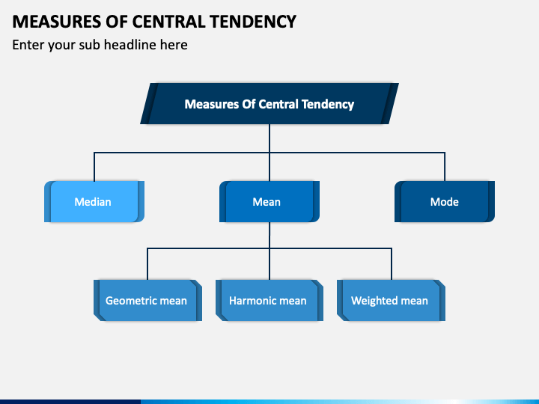
Measure of Central Tendency

Slide 4
Introduction
Measure of central tendency are statistical measures which describe the position of a distribution.
They are also called statistics of location, and are the complement of statistics of dispersion, which provide information concerning the variance or distribution of observations.
In the univariate context, the mean, median and mode are the most commonly used measures of central tendency.
Computable values on a distribution that discuss the behaviour of the center of a distribution.

Slide 5
Measure of Central Tendency
The value or the figure which represents the whole series is neither the lowest value in the series nor the highest it lies somewhere between these two extremes.
The average represents all the measurements made on a group, and gives a concise description of the group as a whole.
When two are more groups are measured, the central tendency provides the basis of comparison between them.

Slide 6
Definition
Simpson and Kafka defined it as “A measure of central tendency is a typical value around which other figures congregate”.
Waugh has expressed “An average stand for the whole group of which it forms a part yet represents the whole”

Slide 7
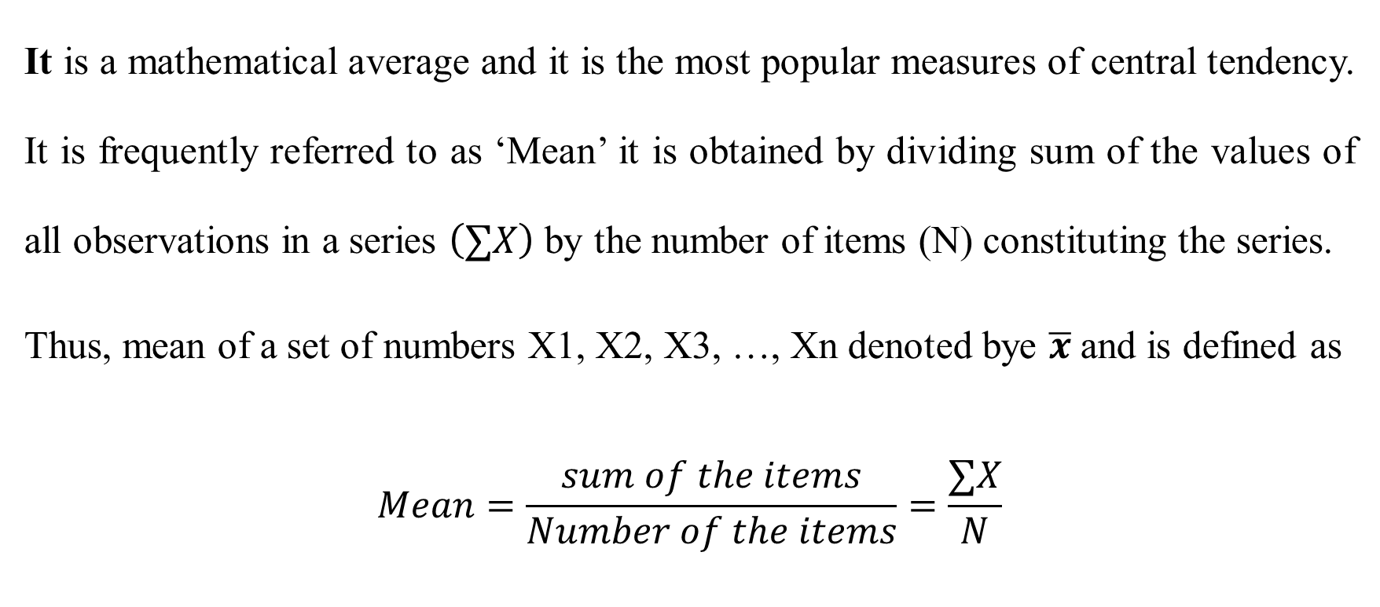
Arithmetic Mean
It is a mathematical average and it is the most popular measures of central tendency. It is frequently referred to as ‘Mean’ it is obtained by dividing sum of the values of all observations in a series $\left(∑X\right)$ by the number of items (N) constituting the series.
Thus, mean of a set of numbers X1, X2, X3, …, Xn denoted bye $\overline{x}$and is defined as
$$Mean=\frac{sum of the items}{Number of the items}=\frac{∑X}{N}$$

Slide 8

Arithmetic Mean Calculated Methods:
Direct Method:
$$\overline{X}=\frac{∑fx}{N}$$
Short cut Method:
$$\overline{X}=A+\frac{∑fd}{N}$$
Step deviation Method:
$$\overline{X}=A+\frac{∑fd}{N}×i$$

Slide 9
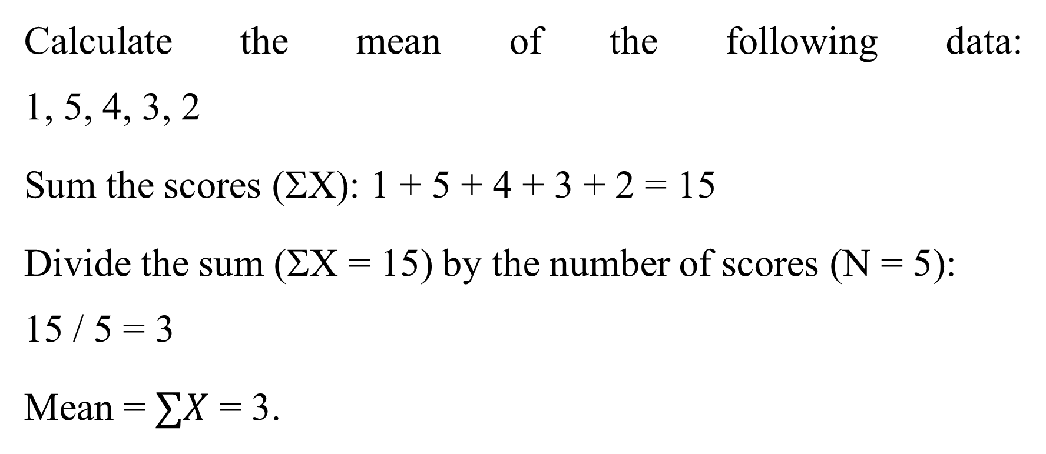
Example:
Calculate the mean of the following data: 1, 5, 4, 3, 2
Sum the scores (ΣX): 1 + 5 + 4 + 3 + 2 = 15
Divide the sum (ΣX = 15) by the number of scores (N = 5): 15 / 5 = 3
Mean = $∑X$ = 3.

Slide 10
Advantages of Mean
It is easy to understand & simple calculate.
It is based on all the values.
It is rigidly defined.
It is easy to understand the arithmetic average even if some of he details of the data are lacking.
It is not based on the position in the series.

Slide 11
Disadvantages of Mean
It is affected by extreme values.
It cannot be calculated for open and classes.
It cannot be located graphically.
It gives misleading conclusions.
It has upward bias.

Slide 12
Median
Median is a central value of the distribution, or the value which divides the distribution in equal parts, each part containing equal number if items. Thus it is the central value of the variable, when the values are arranged in order of magnitude.
Connor has defined as “The median is that value of the variable which divides the group into two equal parts, one part comprising of all values greater, and the other all values than median.”

Slide 13
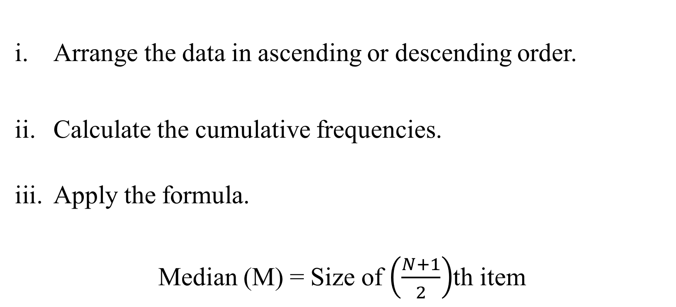
Calculation of Median-Discrete Series
Arrange the data in ascending or descending order.
Calculate the cumulative frequencies.
Apply the formula.
Median (M) = Size of $\left(\frac{N+1}{2}\right)$th item

Slide 14
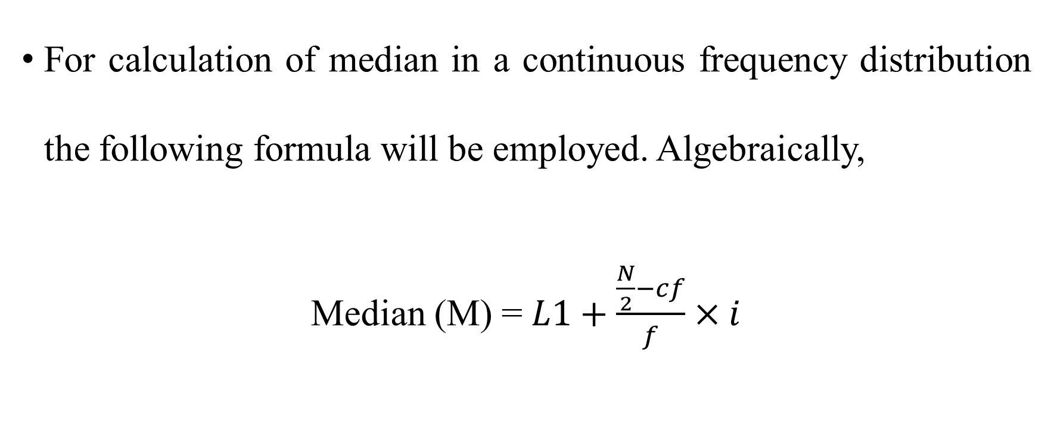
Calculation of median- Continuous Series
For calculation of median in a continuous frequency distribution the following formula will be employed. Algebraically,
Median (M) = $L1+\frac{\frac{N}{2}−cf}{f}×i$

Slide 15
Advantages of Median
It can be calculated in all distributions.
It can be understood even by common people.
It can be ascertained even with the extreme items.
It can be located graphically.
It is most useful dealing with qualitative data.

Slide 16
Disadvantages of Median
It is not based on all the values.
It is not capable of further mathematical treatment.
It is affected fluctuation of sampling.
In case of even no. of values it may not the value from the data.

Slide 17
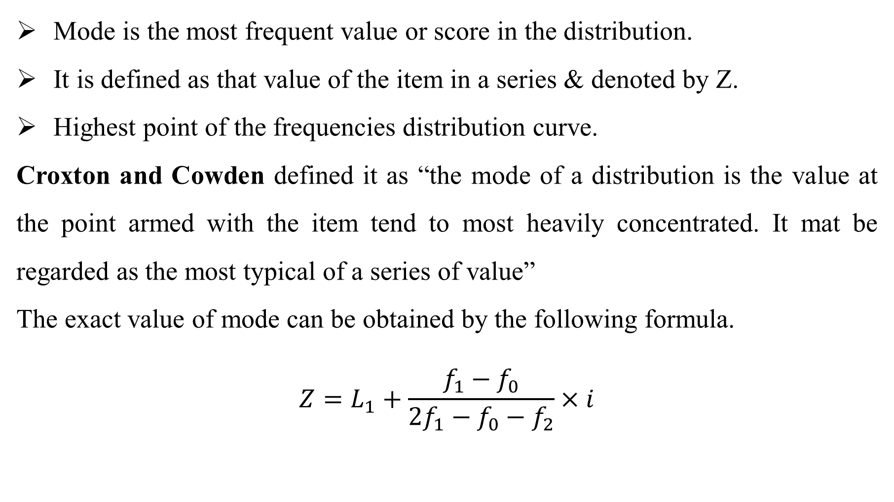
Mode
Mode is the most frequent value or score in the distribution.
It is defined as that value of the item in a series & denoted by Z.
Highest point of the frequencies distribution curve.
Croxton and Cowden defined it as “the mode of a distribution is the value at the point armed with the item tend to most heavily concentrated. It mat be regarded as the most typical of a series of value”
The exact value of mode can be obtained by the following formula.
$$Z=L_{1}+\frac{f_{1}−f_{0}}{2f_{1}−f_{0}−f_{2}}×i$$

Slide 18
Advantages of Mode:
Mode is readily comprehensible and easily calculated.
It is the best representative of data.
It is not at all affected by extreme value.
The value of mode can also be determined graphically.
It is usually an actual value of an important part of the series.

Slide 19
Disadvantages of Mode:
It is not based on all observations.
It is not capable of further mathematical manipulation.
It is affected to a great extent by sampling fluctuations.
Choice of grouping has great influence on the value of mode.

Slide 20
THANKS FOR PAYING ATTENTION
Please Send Your Queries on:
e-Mail: heena.e6398@cumail.in

